Slide 2
Design
Data for Progress conducted a message test
Voters were presented with the Trump argument that he’s done a great job handling the coronavirus crisis
Trump says that he’s done a great job leading the country through a crisis that no one saw coming. The pandemic would be much worse if he hadn’t banned travel from China, and he passed the largest economic relief bill in history to save jobs and help workers. Democrats opposed the travel ban, held the economy hostage for a wish-list of radical leftist policies, and care more about blaming Trump than saving the country.”
This was then countered by a randomized set of progressive arguments, including a control (a generic message hitting Trump for irresponsibility)
Treatment effects were calculated to determine the impact of each message across several dependent variables.

Slide 3
Executive Summary
The most effective messaging focuses on the human damage Trump has done without personally attacking him
Messages with specifics of how he’s slashed the safety net and put Americans at risk with failed pandemic response decreased Trump vote share as well as decreasing approval of his handling of the crisis
Abstracts are less effective, like talking about “the economy” in general
Talking about the human/social cost is effective in changing views about the economy
Detailing Trump’s actions can neutralize his messaging
His failure to provide enough tests and ventilators is a powerful thing to highlight

Slide 4
Messages Tested
Control-Twitter “Trump is too focused on pointing fingers and picking Twitter fights .."
Corona Response “Trump’s disastrous response to the coronavirus pandemic will cost lives. …”
Structural Change “…This crisis shows we need big, structural economic change…”
Safety Net “In the middle of the coronavirus pandemic, Trump slashed the safety net…”

Slide 5
Dependent Variables Tested
Trump vs Biden Whether voters intend to vote for Trump or Biden in the general election. Negative effect = lower Biden voteshare
Corona approval Whether voters approve of Donald Trump’s handling of the coronavirus. Negative effect = lower approval.
Economic conditions Whether voters think the economy is good or bad. Negative effect = thinking the economy is worse.
Economy approval Whether voters approve of Trumps handling of the economy. Negative effect = lower approval.

Slide 6
Topline Findings
Corona Response (hitting Trump for his inadequate response and the associated deaths) performed the best, followed by Safety Net (hitting Trump for slashing the safety net)
Corona Response also was most successful at decreasing approval of Trump’s handling of the crisis
Structural Changes was not effective on increasing Biden support and had high backlash, particularly among Independents
It did decrease approval of the economy with its specific economic focus, but performed poorly on other outcomes

Slide 7
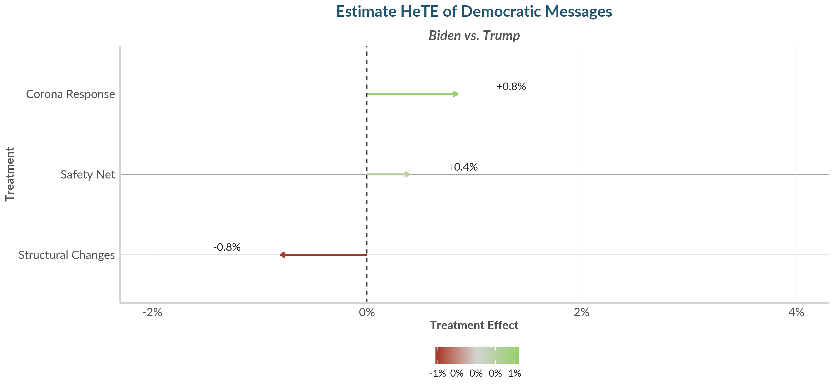
Topline Treatment Effect for Democratic Arguments (All Voters)

Slide 8
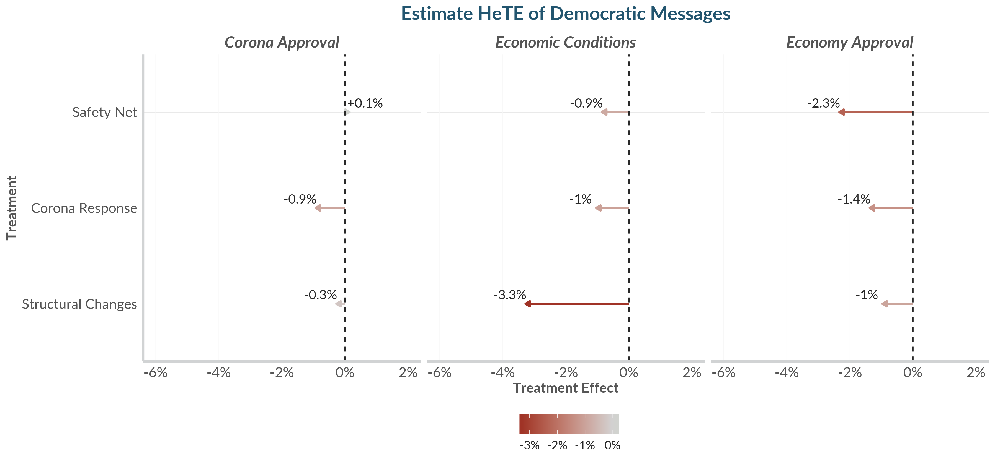
Topline Treatment Effect for Democratic Arguments (All Voters)

Slide 9
Key Takeaways
Focus on the human cost
The best messages hit Trump for putting lives on the line
These messages also decrease approval of economic conditions
Economic-focused messages without enough emotional punch can have backlash, particularly among independents
Details about Trump’s actions help prove your point
Describing the issues with his handling of the crisis significantly outperforms hitting him for finger-pointing and ignoring experts
His abject failure to provide enough testing and ventilators is a persuasive counter to his messaging

Slide 10
Full Message Text
[Control- Twitter] Trump is too focused on pointing fingers and picking Twitter fights to effectively lead the country through this crisis. He’s attacked governors who ask for life-saving equipment, accused health care workers of stealing medical supplies, and taken the advice of right-wing pundits over medical experts. Americans need a leader who will tell the truth, listen to the experts, and bring the country together to defeat this virus.
[Corona Response] Trump’s disastrous response to the coronavirus pandemic will cost lives. He downplayed the severity of the crisis to avoid bad headlines, lied about the availability of testing, and slashed spending on pandemic prevention and health care. The federal government has delivered broken ventilators to states and failed to provide doctors and health care workers with the equipment they need. Americans need a leader who will put fixing this crisis ahead of their own political interests.
[Structural Changes] American workers are currently facing the greatest economic threat since the Great Depression. Trump is focused on short term solutions like bailing out big corporations and Wall Street investors. This crisis shows we need big, structural economic change that means increasing the minimum wage to $15, putting workers on corporate boards, limiting CEO pay and ensuring paid leave for all workers.
[Safety Net] In the middle of the coronavirus pandemic, Trump slashed the safety net and tightened food stamp requirements, putting 700,000 people at risk of losing the money they need to put food on their table. He has also proposed massive cuts to Social Security, Medicaid and Medicare and he is currently supporting a lawsuit that would repeal the Affordable Care Act, making it harder for the poor and elderly to get necessary healthcare.

